Slide 1
POTENTISATION
By
Dr. Ghotia Sapna
Deptt. Of Pharmacy
MNHMC&RI, Bikaner

Slide 3
Definition
It is a mathematico-mechanical process by virtue of which the inherited dormant dynamic curative power of drugs is aroused or increased by modifying drug strength/drug power to dynamic power through simultaneous and successive process of dilution & friction in definite order according to pharmacopoeia.

Slide 4
The doctrine of Drug Dynamisation was introduced in 5th edition of Organon of Medicine, published in 1833.

Slide 5
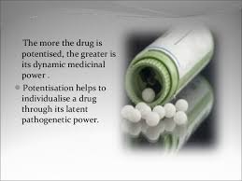

Slide 6
Objectives Of Potentisation
To avoid unnecessary medicinal aggravations.
Quantitative reduction but qualitative increment of medicine.
To arouse latent pathogenetic power of drugs, as discovered through drug proving.
Sphere of action of drugs are broadened than in crude state.
It not only preserves the therapeutic potentiality but also increases the pharmacological and therapeutic activity.
To meet the dynamic Vital force and to cure dynamic diseases and to remove abnormal susceptibilities, constitutional defects, miasms by the deep action of the drug.

Slide 7
Phenomenon of Potentisation
It includes 2 phenomenon:
Dilution
Friction

Slide 8
Processes of Potentisation
Drugs are potentised principally by 2 processes:
Trituration: In case of insoluble substances
2. Succussion: In case of soluble substances

Slide 9
Scales of Potentisation
For Trituration
(i) Centisimal Scale
(ii) Decimal Scale
For Succusion
(i) Centisimal Scale
(ii) Decimal Scale
(iii) 50-Millesimal Scale

Slide 10
Trituration
It is an ideal physical, mathematical process of potentisation by which preparation of medicines takes place by the use of solid vehicle, i.e., sugar of milk, by grinding in definite order according to pharmacopoeia.

Slide 11
Substances taken for Trituration
Dry insoluble medicinal substances (class VII)-e.g. Arsenic Album, Alumina, Calcarea carb, etc.
Liquid insoluble medicinal substances (class VIII)-e.g. Petroleum, Lachesis, Naja, Variolinum, Lyssin, etc.
Fresh vegetable and animal substances (class IX)- e.g. Anthracinum, Psorinum, Blatta orientalis, etc.

Slide 12
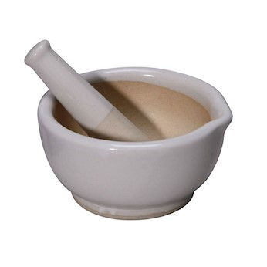
Procedure According to Centesimal
1:99
1+33
Drug+SOM
(20minutes)
(6+3+1)(6+3+1)
33
SOM
(20minutes)
(6+3+1)(6+3+1)
33
SOM
(20minutes)
(6+3+1)(6+3+1)

Slide 13
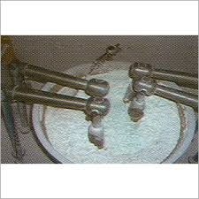

Slide 14
Conversion of Trituration into liquid potency
Conversion into liquid potency takes place from 6X under decimal scale.
The first liquid potency prepared from trituration under decimal scale is 6X and under centesimal scale is 4C

Slide 15
Succussion
It is a process of potentisation of medicinal substances which are soluble in liquid vehicle by downward friction.
The term succussion comes from Latin-succussum succuterre, meaning “shaking up”.

Slide 16
Substances taken for Succussion
Medicinal substances soluble in alcohol or purified water i.e. class I-VI
In class I,II,III,IV &VI alcohol is used as vehicle and in class V first water is used and then after certain attenuation alcohol is used as vehicle.

Slide 18
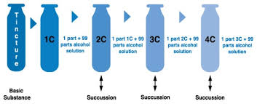
Procedure According to Centesimal

